Slide 1
580 Reddit Posts Classifying Project
Yifen Chen, Jingyi Qi, Changwen Li

Slide 2


Introduction
Reddit is an American social news aggregation, web content rating, and discussion website.
Posts are organized by subject into user-created boards called "communities" or "subreddits",
Category
title
selftext

Slide 3
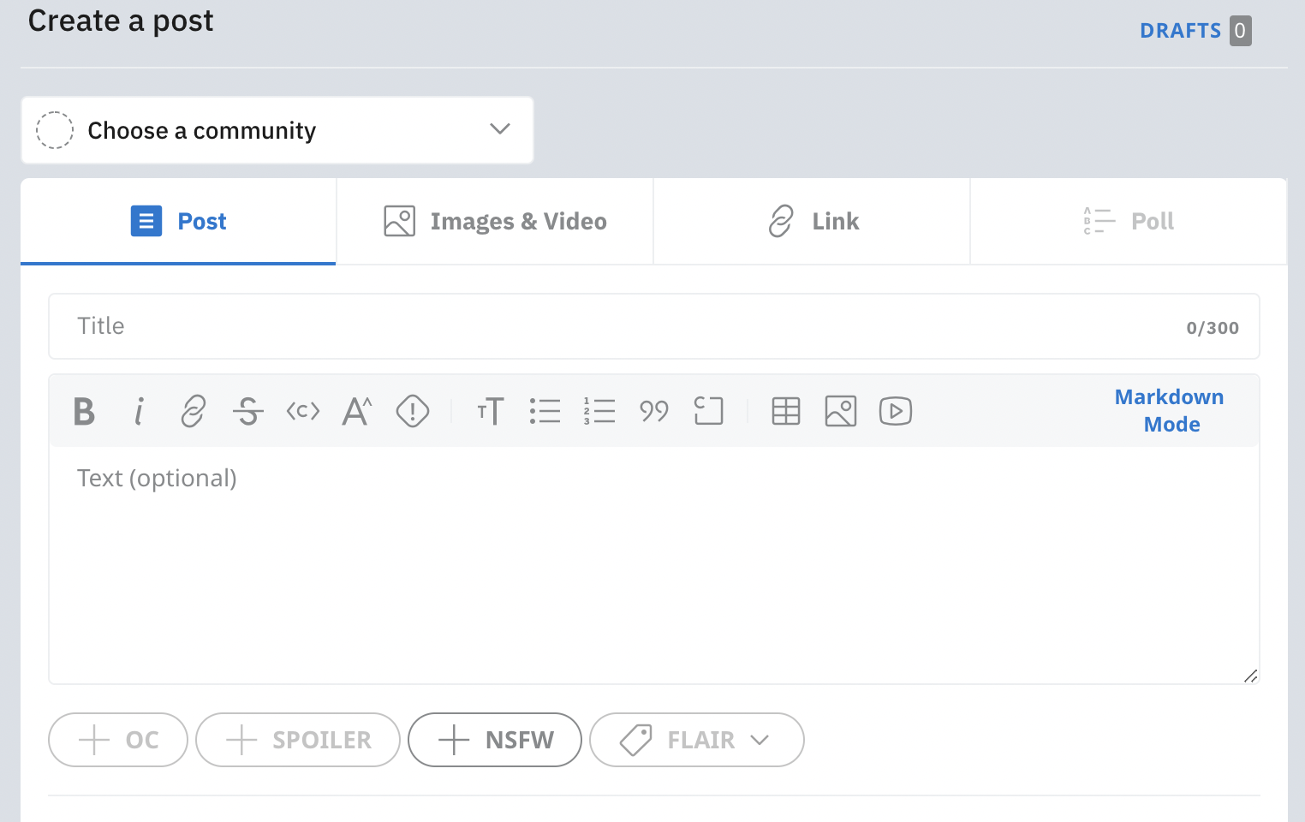
Problem & Goal
Users need to fill the category by themselves
The ultimate goal of this project is to create an automatic classification model for text posts.

Slide 4
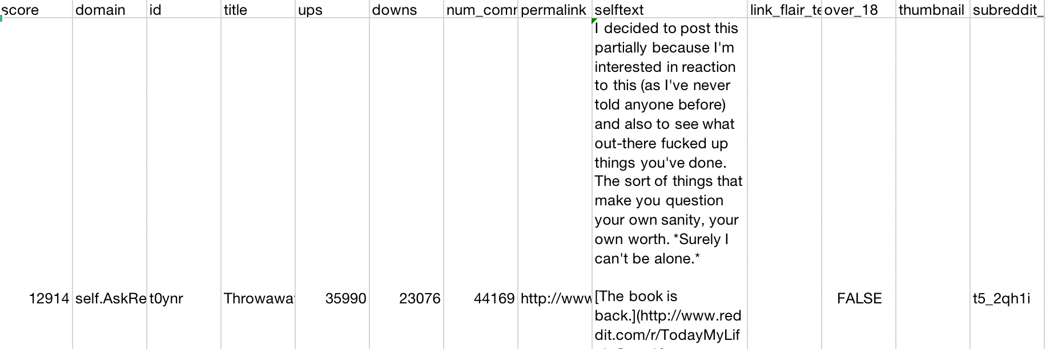
Data
This dataset is downloaded from Kaggle.
It contains top 1000 posts from 18 categories from August 15-20 in 2013.
https://www.kaggle.com/ammar111/reddit-top-1000

Slide 5
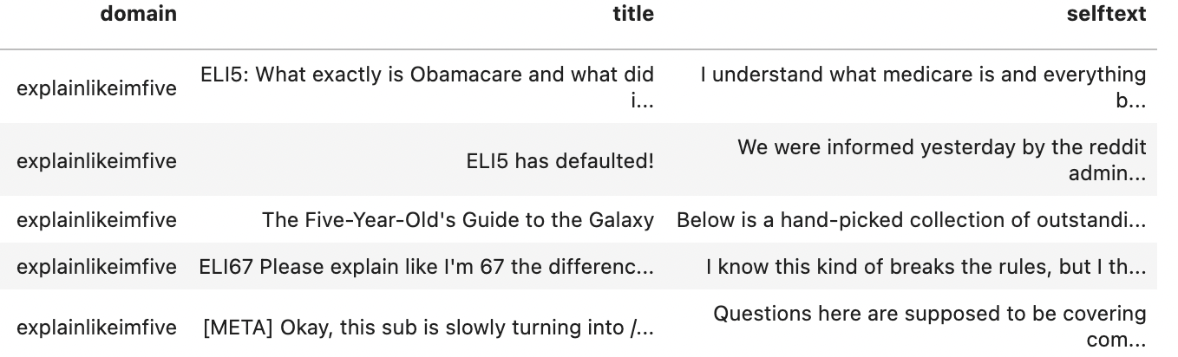
Data Cleaning
Merge data sets that represent different subreddits into one huge dataset
Remove all the other columns except post context and categories
Remove rows containing missing values
Final shape: (4360,3)
https://www.kaggle.com/ammar111/reddit-top-1000

Slide 6
Methodologies
Naive Bayes
XGBoost + Bert
XGBoost + Countvectorizer
XGBoost + Countvectorizer + SVD

Slide 7
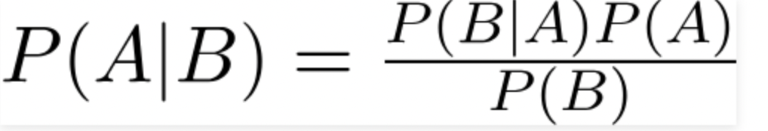
Methodology: Naive Bayes
Naive Bayes classifiers are a family of simple "probabilistic classifiers" based on Bayes' theorem
Assumption 1: The text and label in one document does not affect those of another.
Assumption 2: Words in a sentence are independent, conditioned on the class label

Slide 8
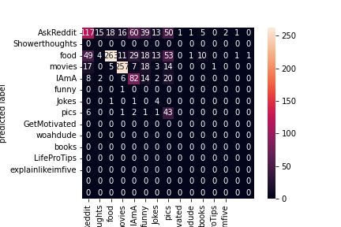
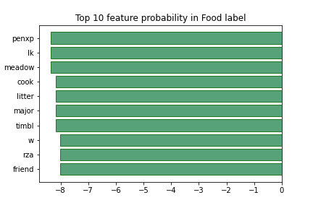
Naive Bayes——Selftext
Accuracy Score | F1 Score | Precision Score
0.5856 | 0.5347 | 0.5506
Kind Of Low, Assumptions Not Satisfied

Slide 9
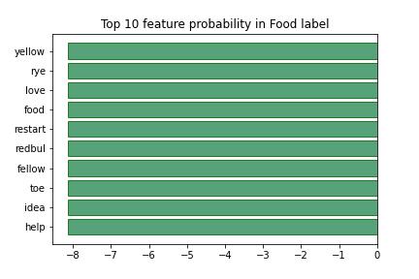
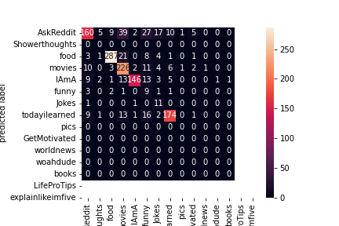
Naive Bayes——Title
Accuracy Score | F1 Score | Precision Score
0.7745 | 0.7483 | 0.7576
Higher, Assumption 2 Satisfied

Slide 10
Methodologies
Bert:
A pre-trained model based on wikipedia data and it captures the context and meaning of the word by utilizing the sentences around it using Transformer which is an encoder-decoder architecture using attention mechanism which means it trains on all nodes, forward and back.
Countvectorizer:
a vector on the basis of the frequency (count) of each word that occurs in the entire text.

Slide 11
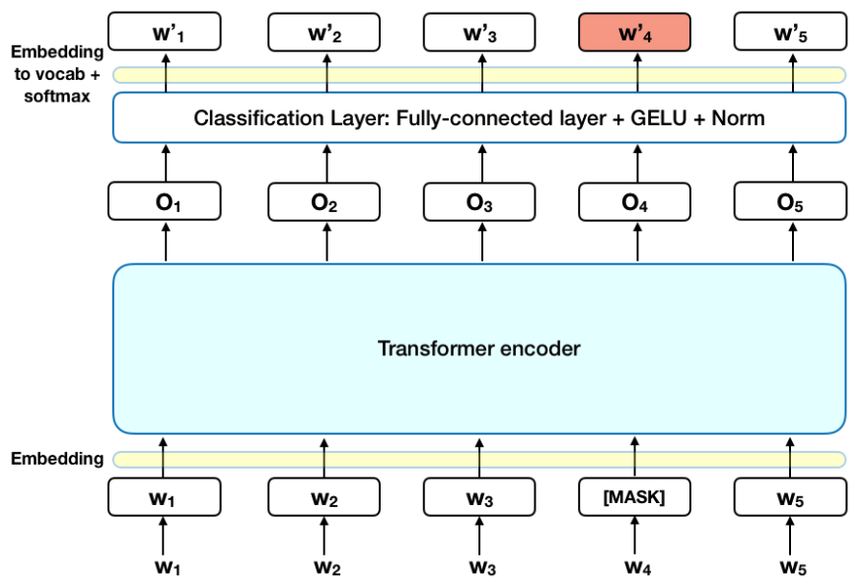
https://towardsdatascience.com/bert-explained-state-of-the-art-language-model-for-nlp-f8b21a9b6270

Slide 12
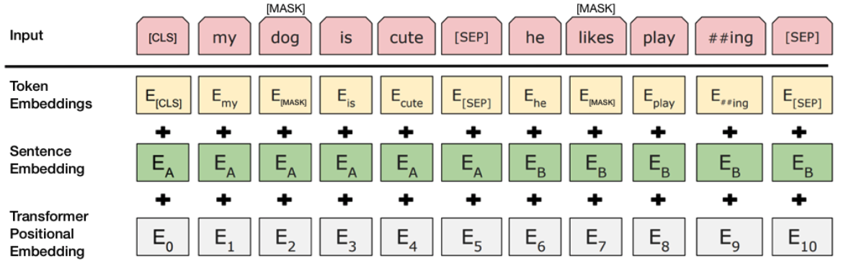
https://towardsdatascience.com/bert-explained-state-of-the-art-language-model-for-nlp-f8b21a9b6270

Slide 13
Methodologies Continues...
SVD:
Singular value decomposition (SVD) is a method of representing a matrix as a series of linear approximations that expose the underlying meaning-structure of the matrix. The goal of SVD is to find the optimal set of factors that best predict the outcome.
XGBoost:
A tree-based(decision tree) ensemble machine learning model scalable for tree boosting.

Slide 14
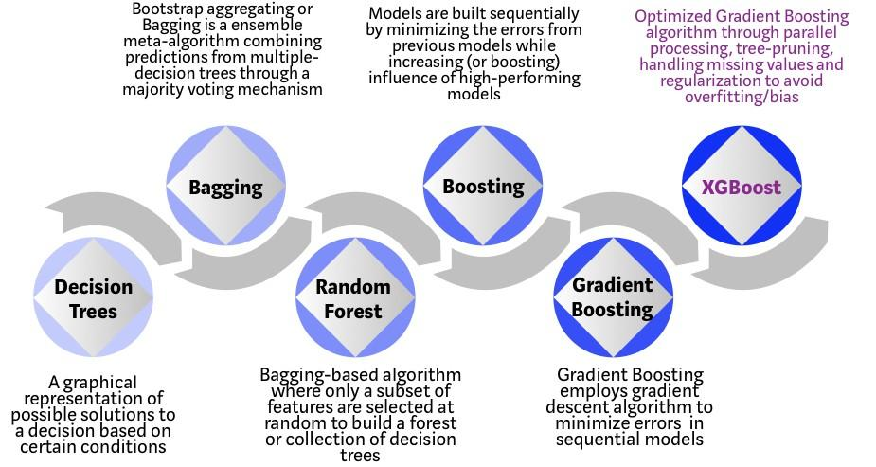
https://towardsdatascience.com/https-medium-com-vishalmorde-xgboost-algorithm-long-she-may-rein-edd9f99be63d

Slide 15
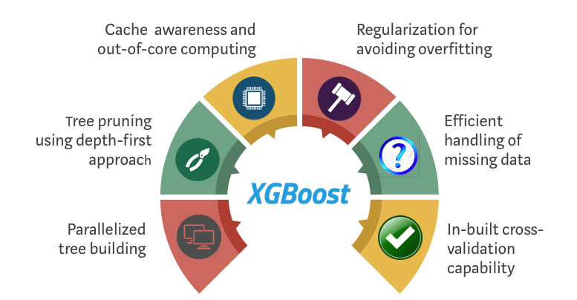
https://towardsdatascience.com/https-medium-com-vishalmorde-xgboost-algorithm-long-she-may-rein-edd9f99be63d

Slide 16
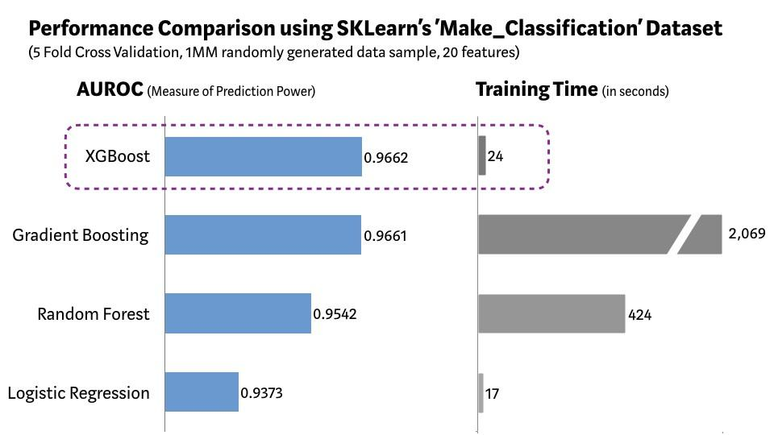
https://towardsdatascience.com/https-medium-com-vishalmorde-xgboost-algorithm-long-she-may-rein-edd9f99be63d

Slide 17
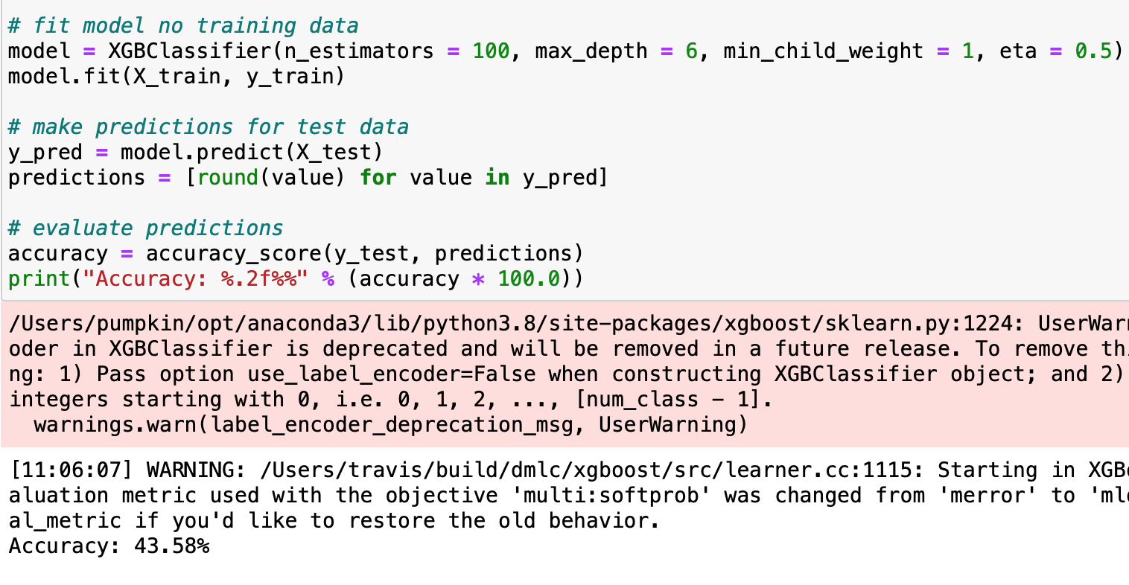
XGBoost + Bert

Slide 18
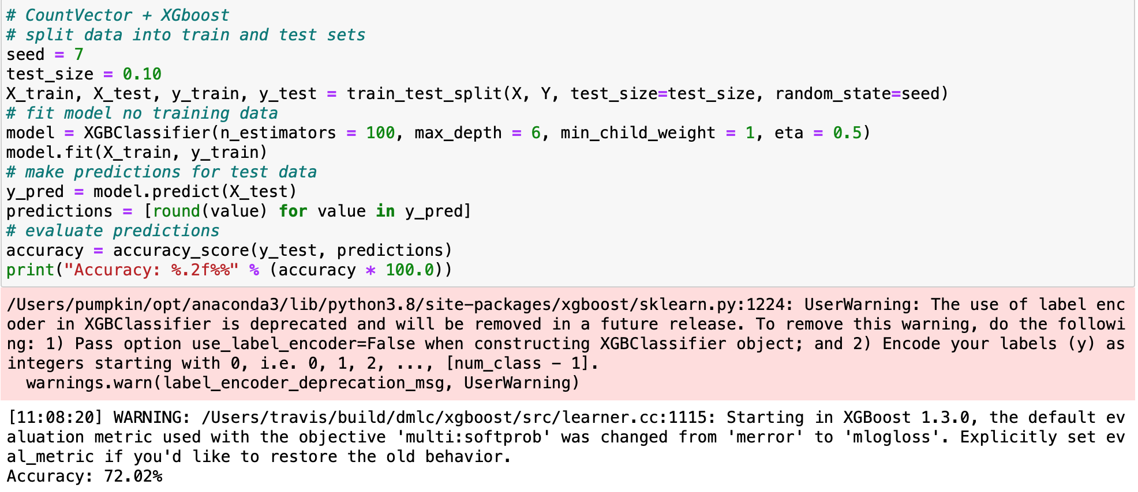
XGBoost + Countvectorizer

Slide 19
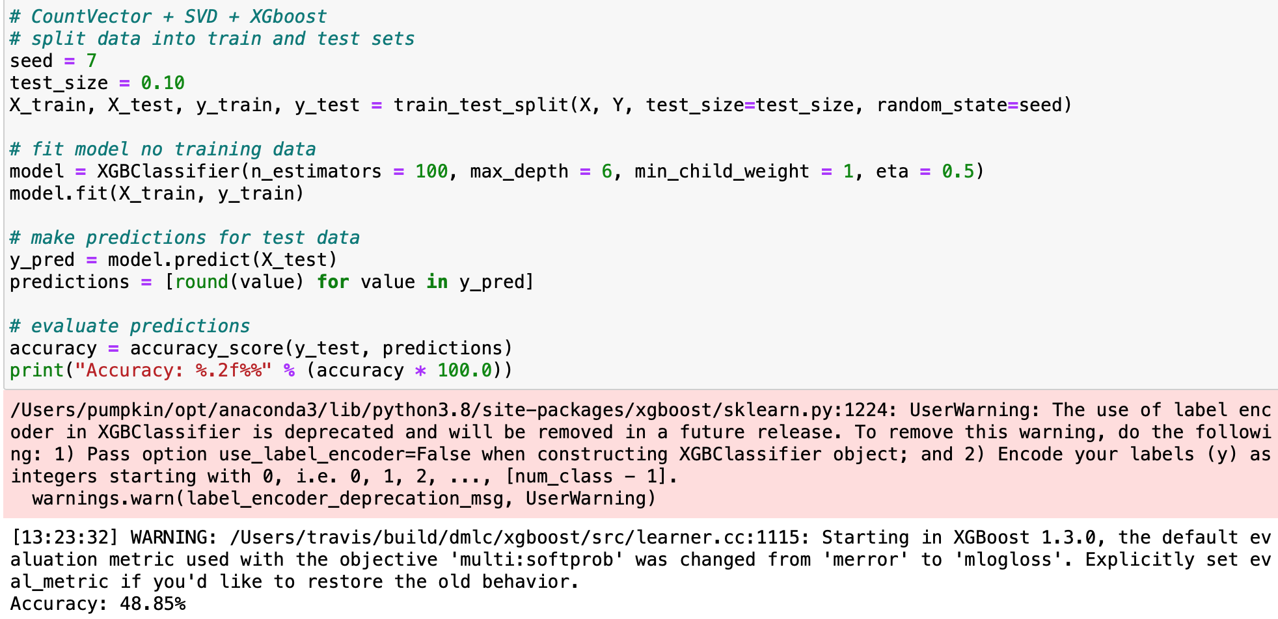
XGBoost + Countvectorizer + SVD

Slide 20
Result Comparison
Model name | F1-Score | Precision | Accuracy | Training Time
Naive Bayes | 53.47% | 55.06% | 58.56% | 13.78s
XGBoost + Bert | 40.64% | 38.28% | 43.58% | 54.55s
XGBoost + Countvectorizer | 70.50% | 70.65% | 72.02% | 7.61s
XGBoost +Countvectorizer +SVD | 46.75% | 45.63% | 48.58% | 5.84s

Slide 21
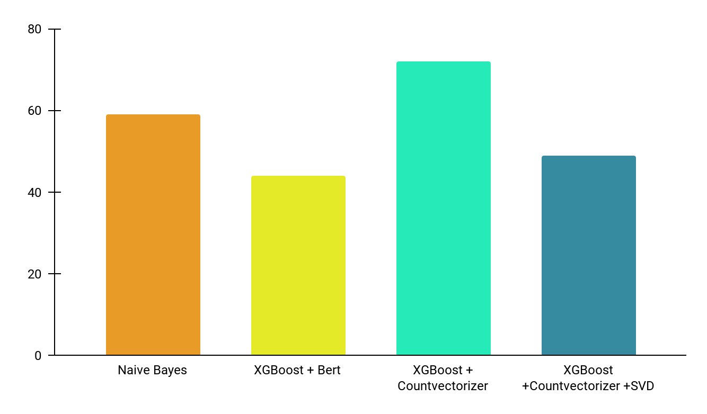
Compare with different classifiers
01
Naive Bayes
02
XGBoost + Bert
03
XGB + Countvectorizer
04
XGB + CV + SVD
XGBoost + Countvectorizer has the best accuracy score.
Although it ranks second in terms of training time, 7.61 seconds is pretty fast.
58.56%
43.58%
72.07%
48.58%
13.78s
54.55s
7.61s
5.84s

Slide 22
Conclusion
XGBoost + Countvectorizer is the optimal model that we tested and compared.
BOW (Countvectorizer) has the best performance in the whole project dealing with Text. The reason could be the single dimensionality of the data.

Slide 23
Possible Improvements
Limitation of data
Our data contains only the first 1000 posts in 18 categories at a short time. Therefore, the data does not include all types and long time periods. If we want our classification model to be more comprehensive, we need to increase the size and dimensionality of the data.
Classification Model Objectives
When we created the Naive Bayes model, we used the title of the post to perform the classification. The accuracy of the created model will be higher than that of selftext. hence, changing the target may result in a higher accuracy model.

Slide 24
Thank you!
Q&A

